Slide 1
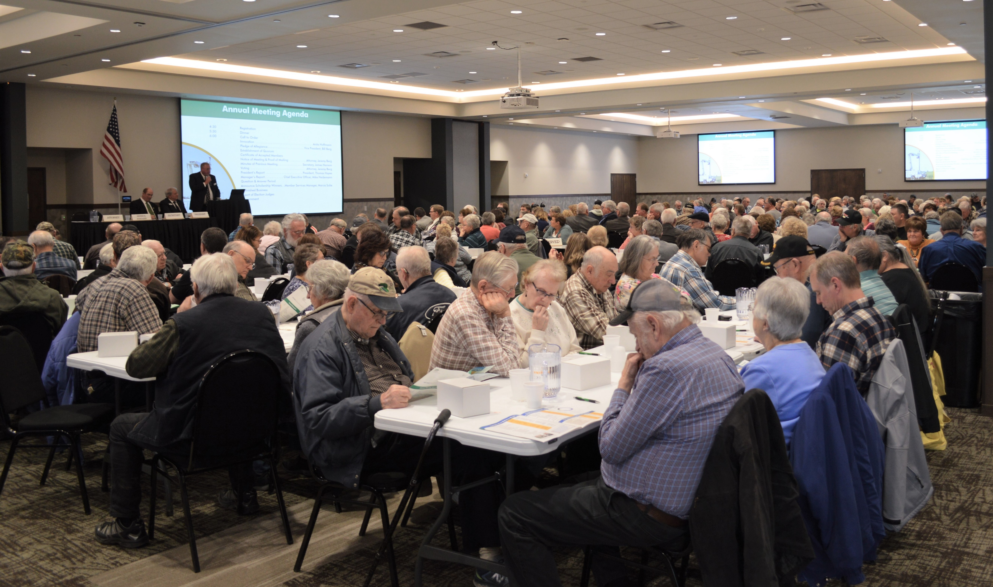

Slide 2
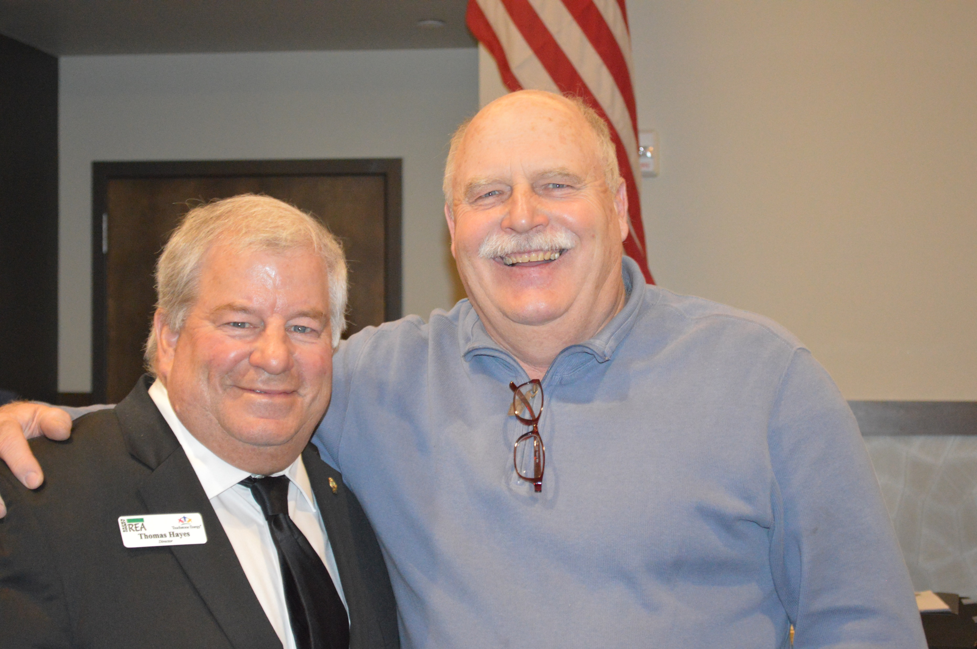
President, Tom Hayes and Nicollet County Commissioner, John Luepke

Slide 3
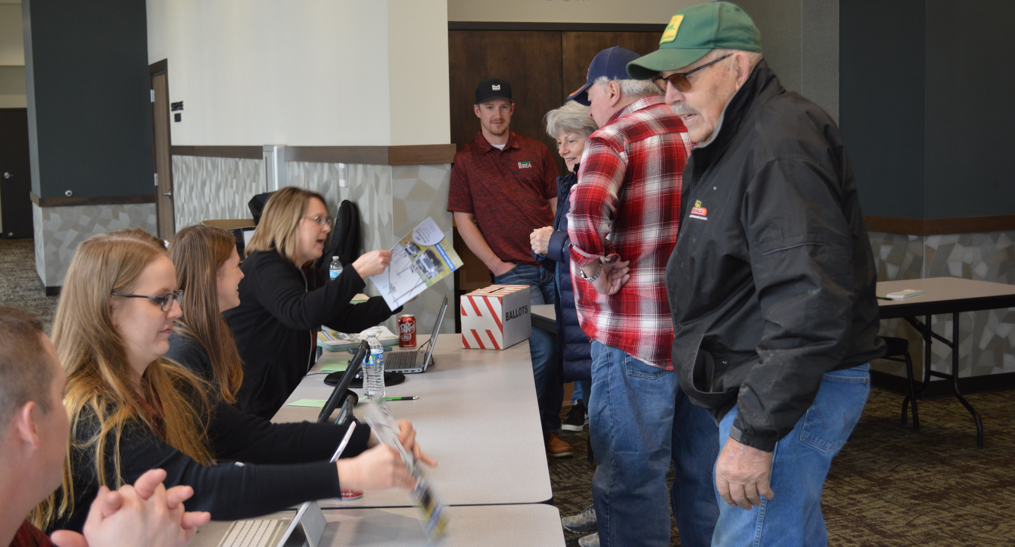

Slide 4
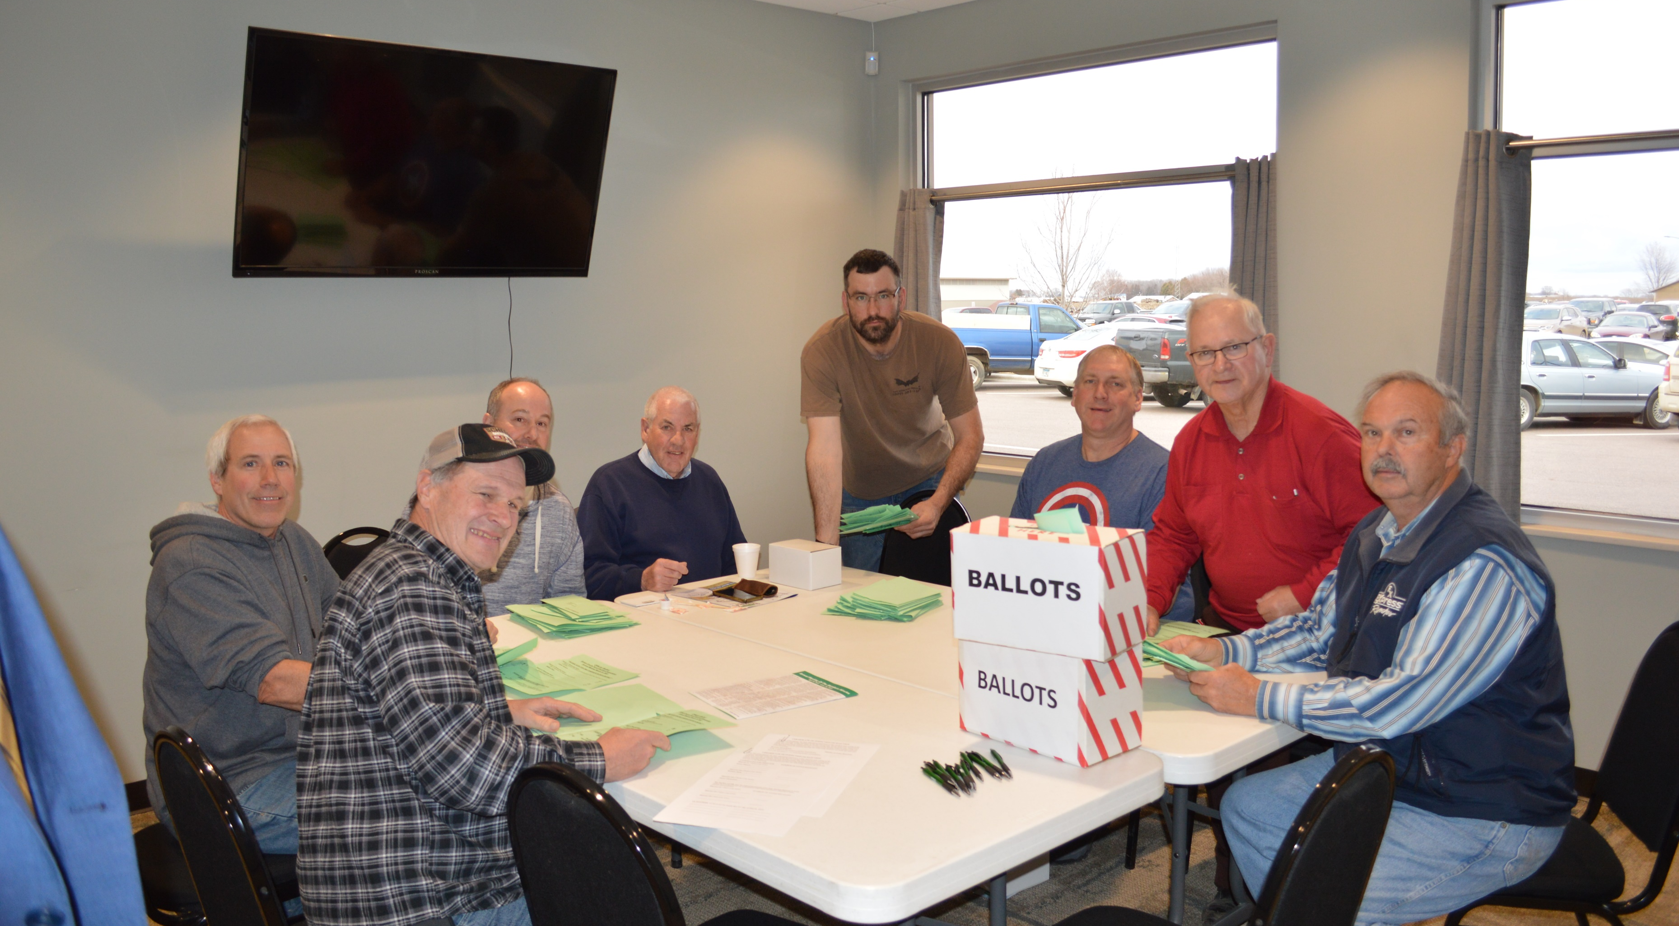
Tellers

Slide 5
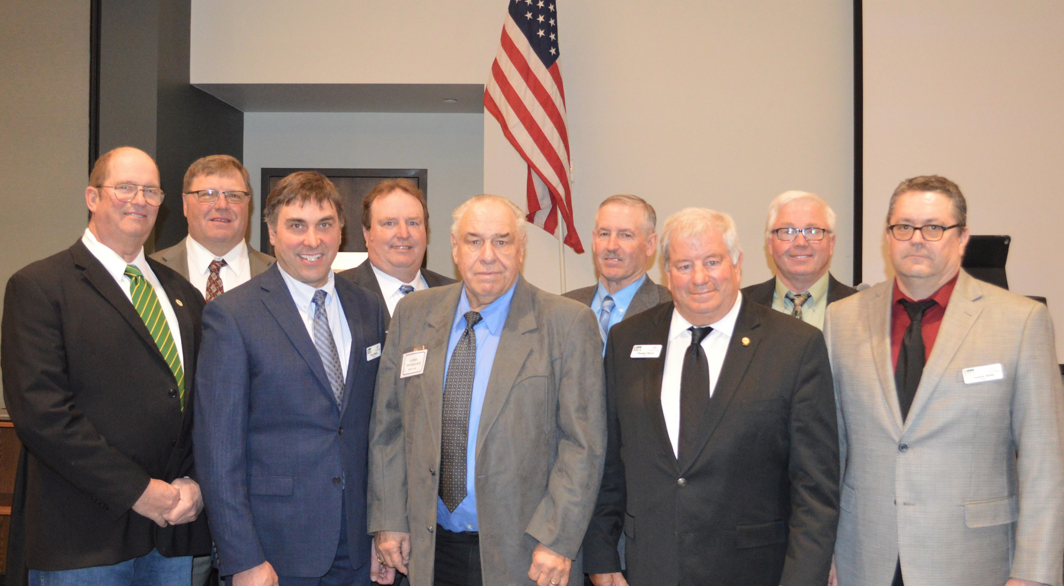
2022 Brown County REA Directors

